Slide 1
Lecture 7 Speeding up your code
Kristin Privitera-Johnson
FISH 553 Advanced R
School of Aquatic and Fishery Sciences
University of Washington

Slide 2
Background / further readings
The Art of R Programming ch. 14 (this lecture), ch. 15 (calling faster languages like C++), ch. 16 (parallel processing)
Hadley Wickham (2014) “Advanced R” CRC Press.
Spring 2014 FISH512 “Super-advanced R” website
https://canvas.uw.edu/courses/896863/files
Using C++ in R
Parallel processing
Speeding up code

Slide 3
What is fast, what is slow?
Running code in the computer memory is 216 times faster than printing results to the console, which is 54 times faster than writing to a file
for (i in 1:1000000) { #0.25 seconds
x <- i
}
for (i in 1:1000000) { #54.0 seconds
print(i)
}
for (i in 1:1000000) { #47 minutes
write.csv(file="temp.csv", i)
}

Slide 4
Lesson
For greater speed move print() or write() statements outside of loops
Instead, save the values in one big object and then print or write it
x <- vector(length=1000000) #11.1 seconds for all
for (i in 1:1000000) {
x[i] <- i
}
write.csv(file="temp.csv", x)
Doing the write() statement once resulted in code that was 220 times faster. There is a trade-off between storage space and speed.

Slide 5
The dreaded c() slowdown
Every time you use the concatenate command c(), R finds a new memory location and copies the two old arguments there. Here, 65 times slower...
x <- vector(length=100000)
for (i in 1:100000) { #0.52 seconds
x[i] <- i
}
x <- NULL
for (i in 1:100000) { #34.0 seconds
x <- c(x,i)
}

Slide 6
Unknown number of loops?
Create a vector big enough for the most extreme case
Store the elements one by one
Trim the vector to the required size after the loop
x <- vector(length=1000000) #0.75 seconds
i <- 0
endpoint <- 100000
while (i < endpoint) {
i <- i+1
x[i] <- i
}
x <- x[1:i]
This example is contrived. But this applies whenever you don’t know what the endpoint value is, or when the loop only stopped if the user intervenes.

Slide 7
Loops are slow, avoid wherever possible
Even the best written loops are amazingly slow compared to vectorized code. In this example, 2000 times slower
x <- vector(length=100000) #0.52 seconds
for (i in 1:100000) {
x[i] <- i
}
x <- 1:100000 #0.00028 seconds

Slide 8
Measuring speed
Use system.time(expr) to compare the speed of different types of expressions in seconds
For a single expression (e.g. for loop):
> system.time( x <- 1:100000000 )
user system elapsed
0.14 0.33 0.46
For complex expressions, enclose in { }
system.time( {
x <- NULL
for (i in 1:100000) {
x <- c(x,i)
}
} )

Slide 9
Speed in nanoseconds
The precision of system.time() is in milliseconds, but microbenchmark(expr1, expr2, expr3, ...) in library microbenchmark measures time in nanoseconds
Useful for comparing short statements, without needing a loop that runs many times to get a non-zero speed estimate
Compares the run-time of each expression passed to it by executing the expression 100 times (ordered randomly) and reporting median, range, quartiles of runtime
Can plot the iterations
Notes from H. Wickham (2013) http://adv-r.had.co.nz/Performance.html

Slide 10
microbenchmark()
require(microbenchmark)
f <- function() { 3+3 }
microbenchmark(
3+3,
f()
)
Unit: nanoseconds
expr min lq median uq max neval
3 + 3 0 550 551 551 9347 100
f() 1100 1100 1101 1650 9897 100
Expression 1: evaluate the speed of 3+3
Expression 2: evaluate the speed of calling f() which evaluates 3+3
Expression, minimum, lower quartile, median, upper quartile, maximum, num evaluations
Conclusion: the function call itself, and associated overhead, takes about 550 nanoseconds—about as long as it takes R to evaluate the expression!

Slide 11
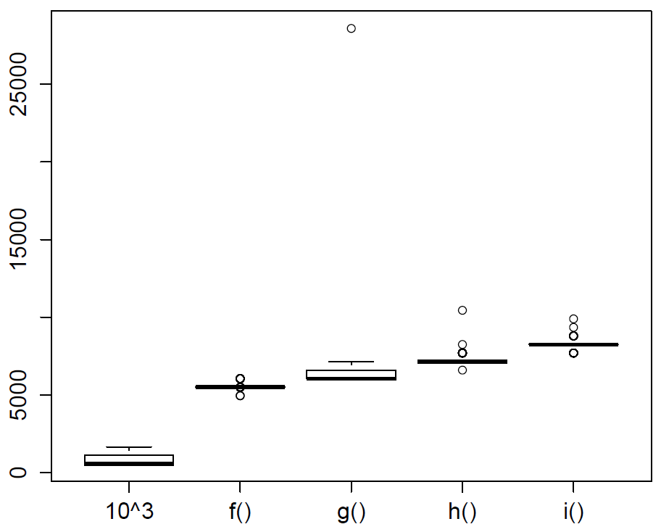
Nanoseconds for one run
Expression evaluated

Slide 12
Vectorization is good
Use vector operations instead of loops: sum, cumsum, diff, rowSums, colSums, rowMeans, colMeans, ifelse
f <- function(mat) {
n <- nrow(mat)
res <- vector(length=n)
for (i in 1:n) {
res[i] <- mean(mat[i,])
}
return(res)
}
g <- function(mat) { rowMeans(mat) }
mat <- matrix(runif(50*100), ncol = 100)
microbenchmark(f(mat),g(mat))
rowMeans 34 times faster than looping

Slide 13
Cautionary tale: apply()
Not all vectorized operations result in a huge code speed-up
Only internal operations that are written in C++ code are fast
Many functions are written in R code and apply() is one of these
However, lapply() does offer a code speedup

Slide 14
f <- function(mat) {
n <- nrow(mat)
res <- vector(length=n)
for (i in 1:n) {
res[i] <- mean(mat[i,])
}
return(res)
}
g <- function(mat) { rowMeans(mat) }
h <- function(mat) {
apply(X=mat, MARGIN=1, FUN=mean)
}
mat <- matrix(runif(50*100), ncol = 100)
microbenchmark(f(mat), g(mat), h(mat))
Unit: microseconds
expr min lq median uq max neval
f(mat) 1747.811 1773.652 1793.445 1862.169 2199.197 100
g(mat) 43.984 45.909 52.232 53.881 116.559 100
h(mat) 1619.708 1651.046 1722.245 1762.106 4621.061 100

Slide 15
Advanced code speedup
See lectures in Super-Advanced R https://canvas.uw.edu/courses/896863/files
See chapters in Advanced R by Hadley Wickham
Byte code compilation: compile() in package compiler
Rewrite the critical piece of code in a lower level language like C++ using package R2cpp
Some code can be run in parallel on multiple CPU processors or computers using packages snow, doParallel, and foreach
Profile your code to detect bottlenecks

Slide 16
Profiling R code
With existing, slow code we can “profile” it to see how much time is spent on each calculation
There are many ways to do it, but the most basic is Rprof and summaryRprof
This reports time in either “total” or “self”. We usually want self.
Basic idea: start the profiler, run some code, stop profile, summarize results.
Let’s look at what is slow about the lm function.

Slide 17
Profiling R code
> Rprof()
> x <- rnorm(1e6); y <- x + rnorm(1e6)
> mod <- lm(y~x)
> Rprof(NULL)
> prof <- summaryRprof()
> head(prof$by.self)
self.time self.pct total.time total.pct
"as.character" 0.40 25.32 0.40 25.32
".External2" 0.38 24.05 0.66 41.77
"lm.fit" 0.26 16.46 0.28 17.72
"rnorm" 0.22 13.92 0.22 13.92
"na.omit" 0.12 7.59 0.28 17.72
"na.omit.data.frame" 0.06 3.80 0.16 10.13
Start profiler, saves to file Rprof.out
Generate data and fit model
Stop profiler
Create summary and print to console
Percent of time for each function on left. 1/4 of time is spent converting something to character. Lesson: It can be hard to predict what is slow

Slide 18
Code speedup advice
Human time counts just as much as CPU time. Don’t spend 1hr making your code run 10 minutes faster.
Speed is most critical for repetitive tasks. If you only do something once, it’s OK to wait.
https://xkcd.com/1205/
https://xkcd.com/974/
https://xkcd.com/1319/
Don’t sacrifice readability for unnecessary speed ups
Do not assume you know what is slow in code (bottlenecks). Profile your code before doing any speedups!

Slide 19
In-class exercise 1
Create a function f() that returns 10³
Create a function g() that returns the result of f()
Create a function h() that returns the result of g()
Create a function i() that returns the result of h()
Now... use microbenchmark to compare the speed of executing 10^3 (by itself), f(), g(), h(), and i()
Save the call to microbenchmark in an object res
Call plot(res) which will display a boxplot comparing the 100 iterations of each call
Results show the overhead of function calls

Slide 20
In-class exercise 2
Use profiling to identify the bottleneck of the function on the next slide.
Look at both self and total time and try to make sense of them.
Does the bottleneck make sense?
Once you’ve identified the bottleneck, fix it and reprofile.
What is slow now? Can we fix that?

Slide 21
Fake function to profile
#A very contrived function for this exercise. Related to Ex2 of lecture 3.
slopes_function <- function(){
slopes <- rep(NA, length=200)
for (i in 1:200) {
data <- read.csv("lecture7.csv", header=TRUE)
one <- data[data$id==i,]
reg <- lm(y~x, data=one)
slopes[i] <- coefficients(reg)[2]
}
}

